Slide 1

Analysis of COVID Severity among US States
PRACTICUM IN
BUSINESS ANALYTIC
SANGHEE HONG

Slide 2

- CONTENTS -
Project Overview
Exploratory Data Analysis
Predictive Analysis
Conclusion

Slide 3

PROJECT OVERVIEW

Slide 4





The Most Powerful
The Most Urgent Issue
at everywhere NOW
PROJECT
BACKGROUND
Jan 5
WHO published new virus news with first outbreak in China
Jan 15
First USA Case in Washington
Mar 6
Last In-Person Class at Hofstra University
Mar 7
NY declares a Disaster Emergency
Mar 16
NY orders shut down, CA shelter in place
Apr 28
Total Cases across USA surpassed 1 million

Slide 5
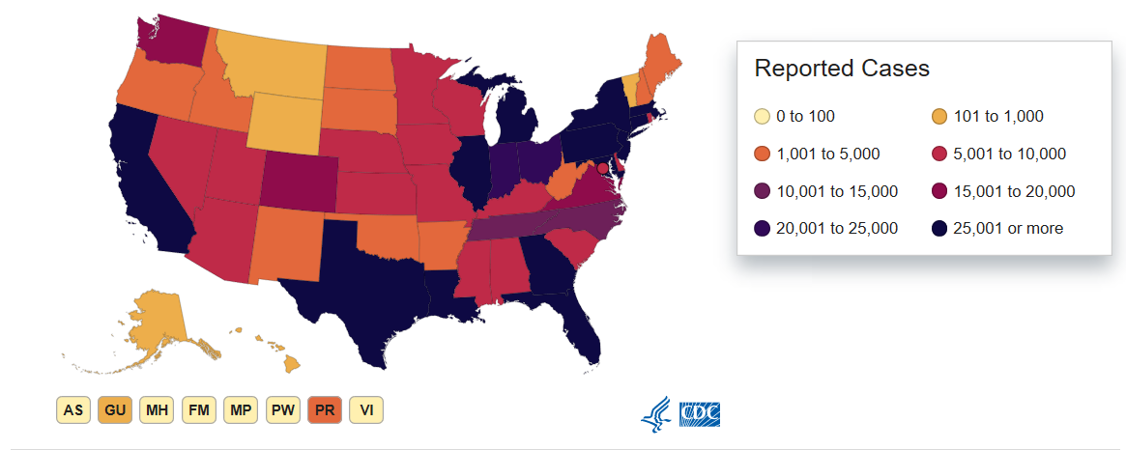
Source : CDC
As of May 6
MI
C : 43,950
D : 4,135
NY
C : 313,836
D : 24,717
IL
C : 63,840
D : 2,662
PA
C : 50,092
D : 2,458
NJ
C : 128,269
D : 7,910
CA
C : 54,937
D : 2,254
TX
C : 32,332
D : 884
FL
C : 36,897
D : 1,399
C : Number of cases
D : Number of deaths

Slide 6


Why New York becomes the epicenter of
this corona virus?
Why severity is so different
among states?
Would there be any potential factors
that accelerated the spread?
Business
Question

Slide 7

KEYWORDS from MEDIA & NEWS
Literature
Review
Metropolitan
Race
Density
Restaurants
Population
Travel
Diversity
Poverty
Transit
Working-Class

Slide 8





Demographic
Density is the strongest factor in affecting COVID cases.
Higher COVID incidence is in regions having more race diversity.
Hypothesis
Economic
Higher COVID incidence is in regions having higher poverty and lower income.
Social
Higher COVID incidence is in regions having higher rate of essential job field.
HealthCare
Higher COVID incidence is in regions having higher fatality rate of other disease.

Slide 9







CDC : COVID data
U.S Census Bureau : Demographic data
Bureau of labor statistics : Employment data
Dept. of housing and urban development
: Social data
CMS, Health Data.gov : Hospital data
Wikipedia, Google Search
Data Source

Slide 10

Demographic
Population / Density
Race, Gender, Education, Marital status
Income / Poverty / Mortgage
Job Field / Commute type / time
Homeless
Hospital condition & rating
Insurance type
Other disease Fatality
Variables
Economic
Social
HealthCare

Slide 11

Exploratory
Data
Analysis

Slide 12
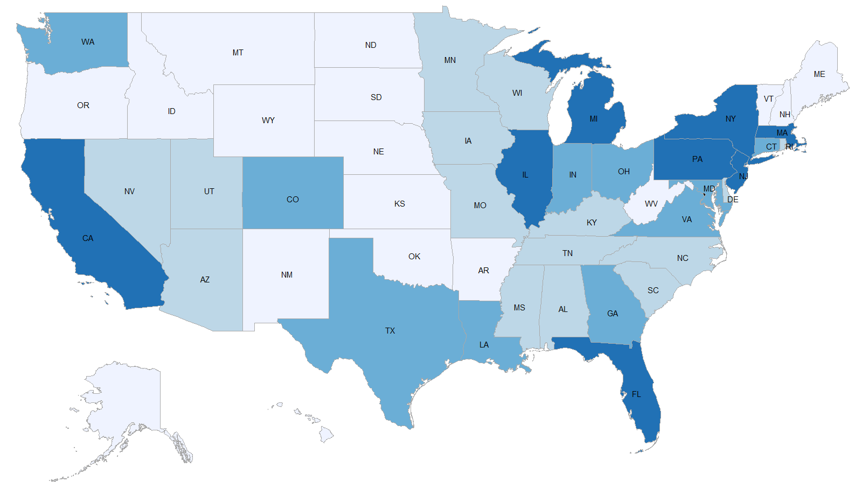
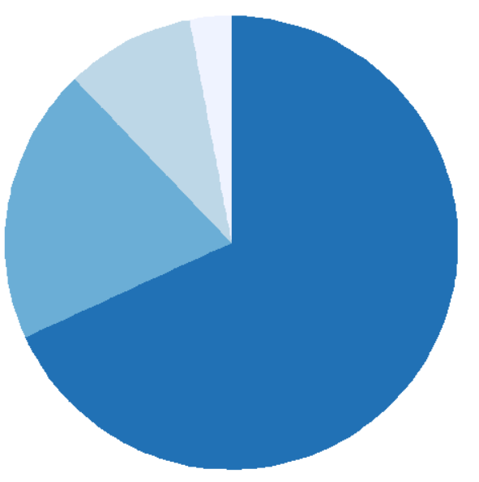
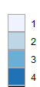
Grouping by COVID Severity
COVID Cases | Group 1 | Group 2 | Group 3 | Group 4
Mean number | 1,677 | 5,839 | 18,782 | 81,329
3%
9%
20%
68%
Low ( <3,500) // 17 states
Moderate ( <10,000) // 15 states
High ( <30,000) // 10 states
Very High (30,000 < ) // 8 states
As of 25th, April

Slide 13
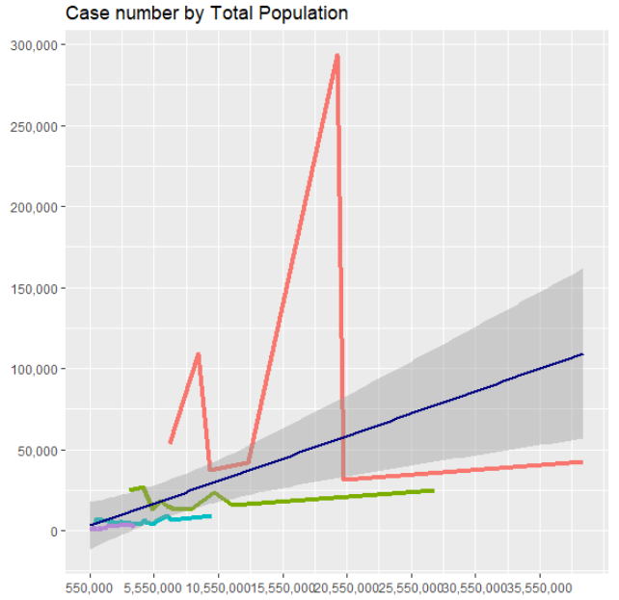
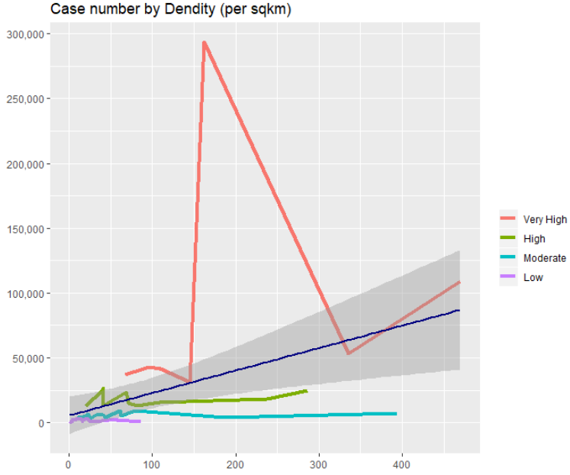
Demographic (Race)
DEMOGRAPHIC
Total Population
Density
★ ★ | Total Population | 0.615
★★ | Density (per km) | 0.404
★ ★ | Men Population | 0.548
★ ★ | Women Population | 0.562
Generally, the higher the population and the density are,
the higher the number of cases are.

Slide 14
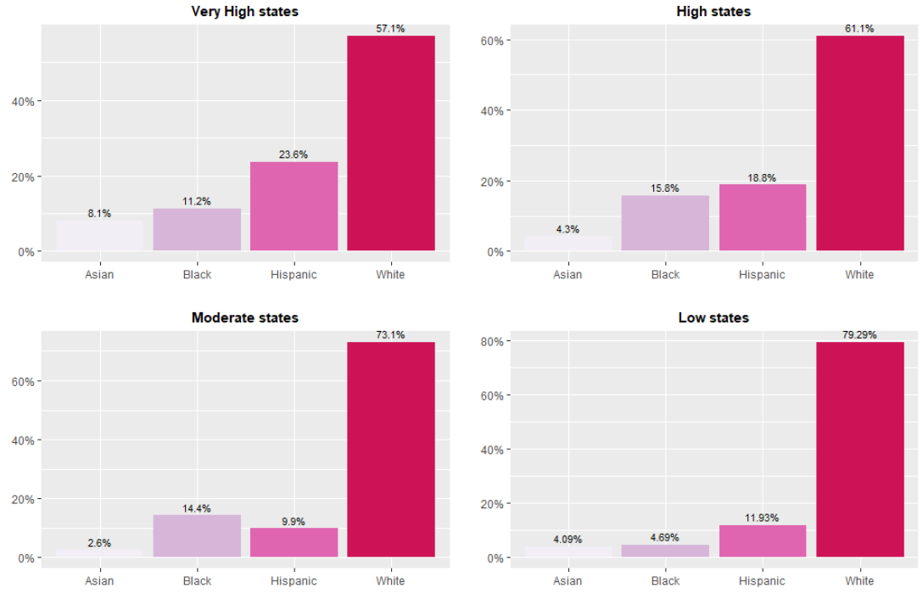
Demographic (Race)
DEMOGRAPHIC
Race Composition
★ | Hispanic Population | 0.284
★ | Hispanic Percent | 0.207
★ ★ | White Population | 0.503
★ | White Percent | -0.240
★ ★ | Black Population | 0.482
★ | Black Percent | 0.154
★ | Asian Population | 0.383
★ | Asian Percent | 0.180
COVID higher states show more diversity in race.
In terms of population rate, only the white shows negative correlation with COVID cases.

Slide 15
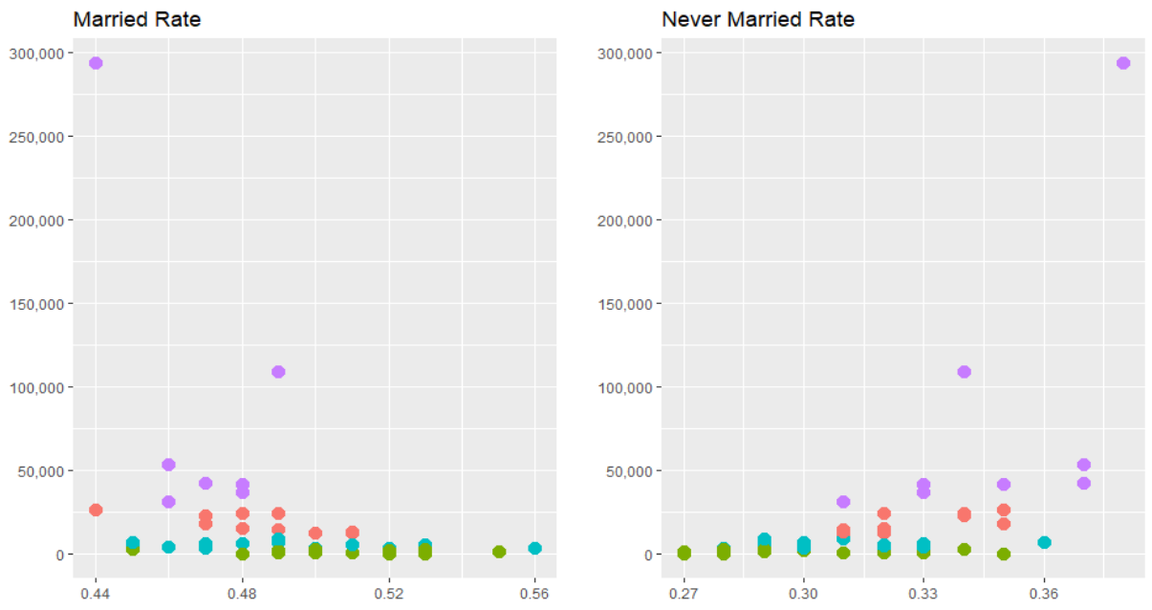
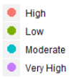
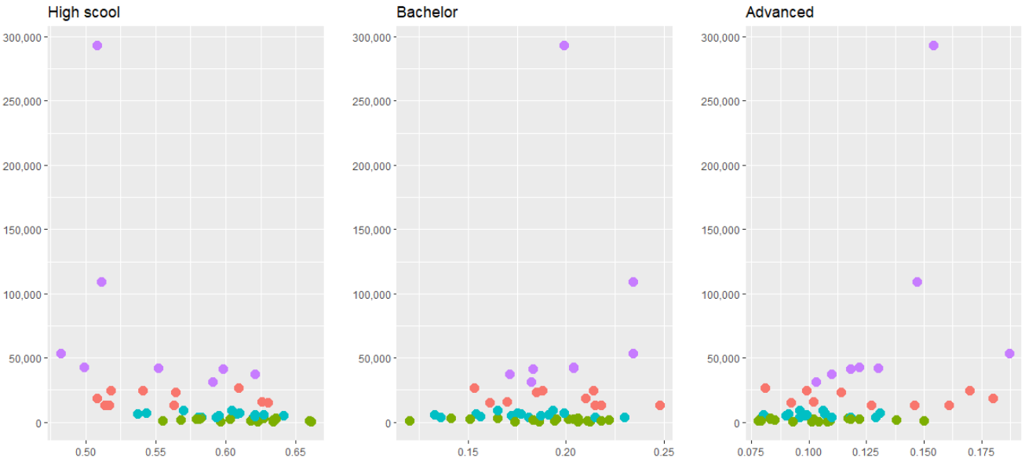
Demographic (Race)
DEMOGRAPHIC
Marital Status
★ | Married rate | -0.381
★ ★ | Never Married rate | 0.510
★ ★ | High school only rate | -0.444
★ | Bachelor degree rate | 0.170
★ | Advanced degree rate | 0.376
★ | Median Age | 0.048
★ | Age over 65 rate | -0.094
Education
COVID high states have more single rate than married.
COVID high states have more higher degree rate.

Slide 16
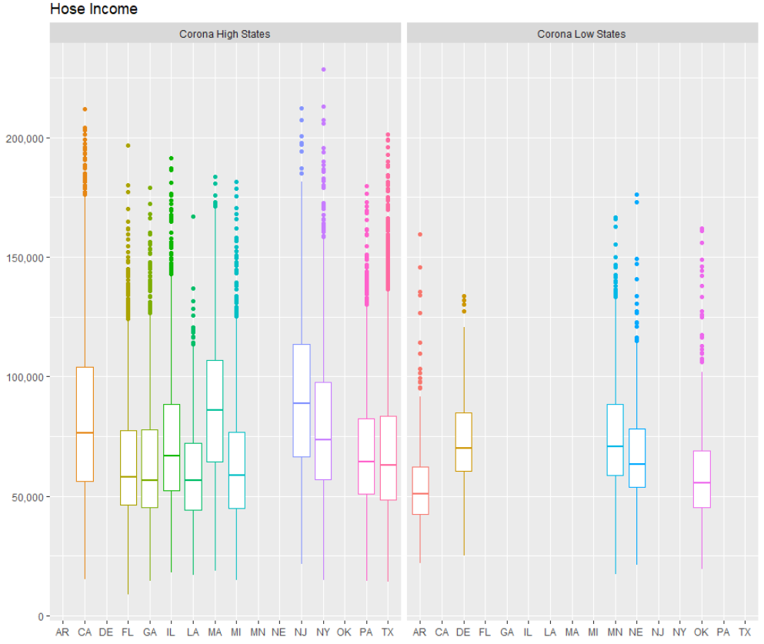
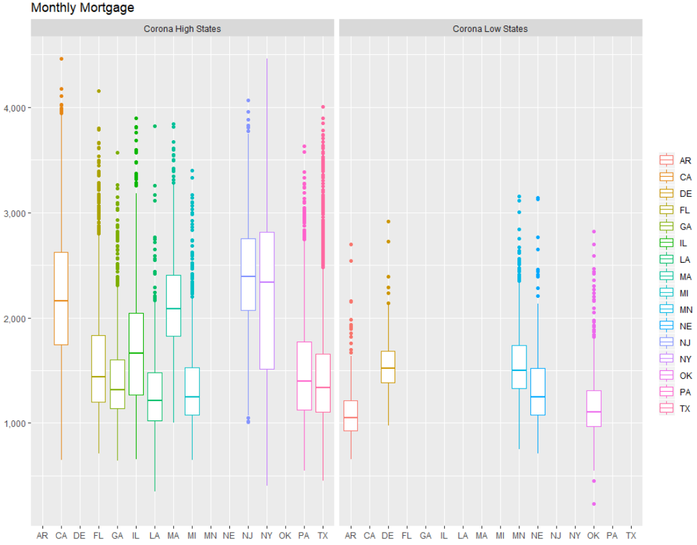
Demographic (Race)
ECONOMIC
Annual Income
Monthly Mortgage
★ | Annual Income | 0.331
★ | Monthly Mortgage | 0.309
COVID high states show higher income and mortgage with longer range in general.
COVID Level | Annual Income (mean) | Monthly Mortgage (mean)
Low | 59,412 | 1,715
Moderate | 57,822 | 1,642
High | 65,734 | 1,987
Vey High | 67,849 | 2,167
Notes:
Although less outliers, but the problem are more generalized.

Slide 17
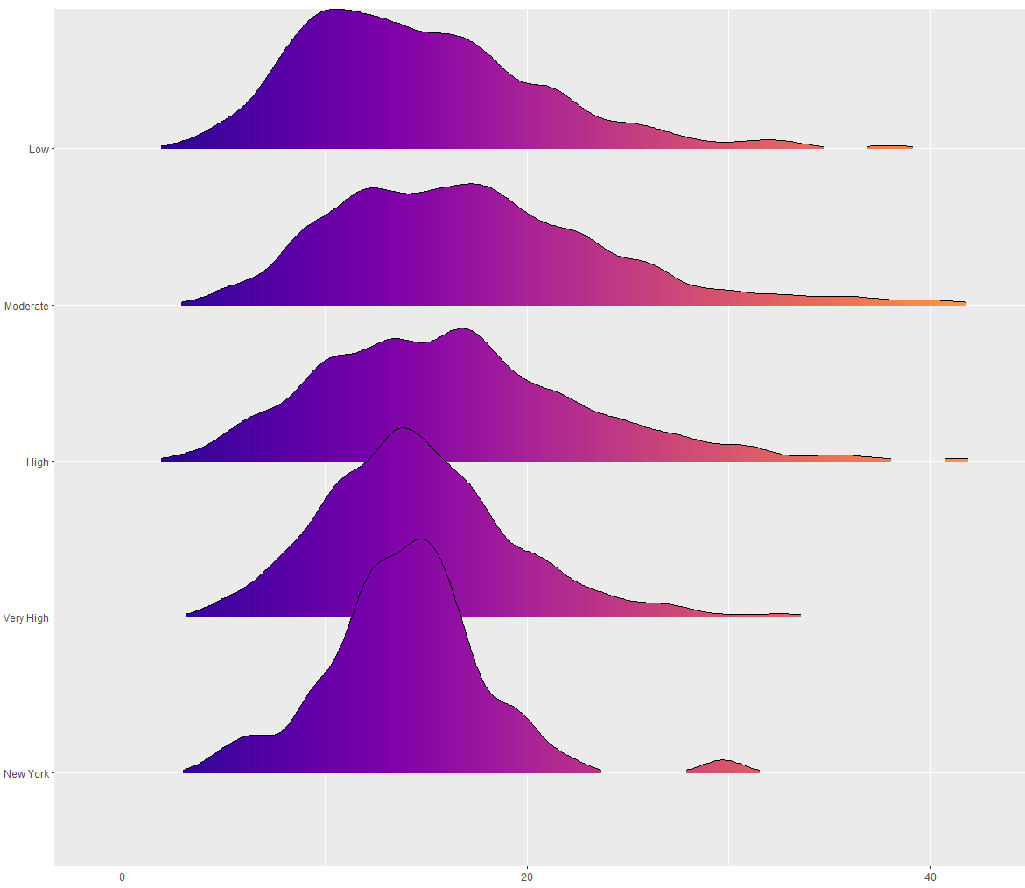
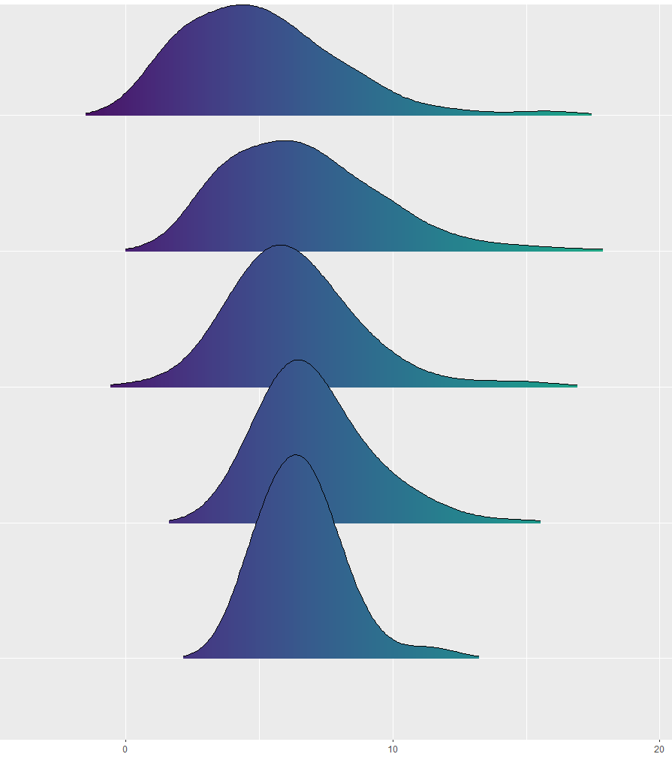
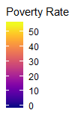
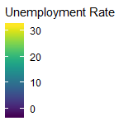
Demographic (Race)
ECONOMIC
Poverty Rate
Unemployment Rate
Low
★ ★ | Poverty rate | 0.640
★ ★ | Unemployment rate | 0.519
★ ★ | Homeless number | 0.625
MODERATE
High
COVID high states also show higher poverty rate with more unemployment and homeless people.
These rate values are more centered around mean in COVID high states.
Very High
NY

Slide 18
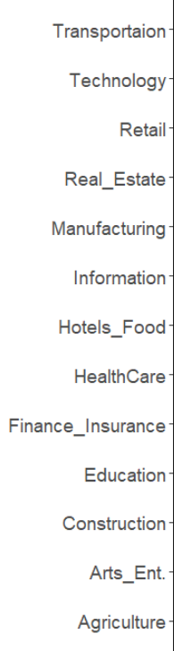
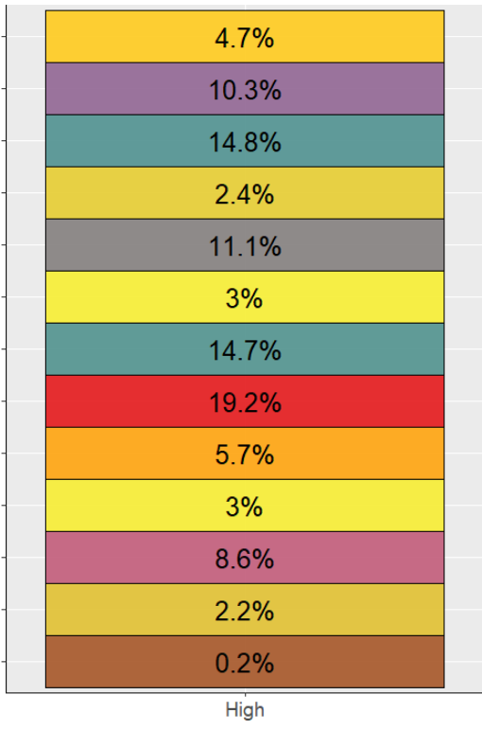
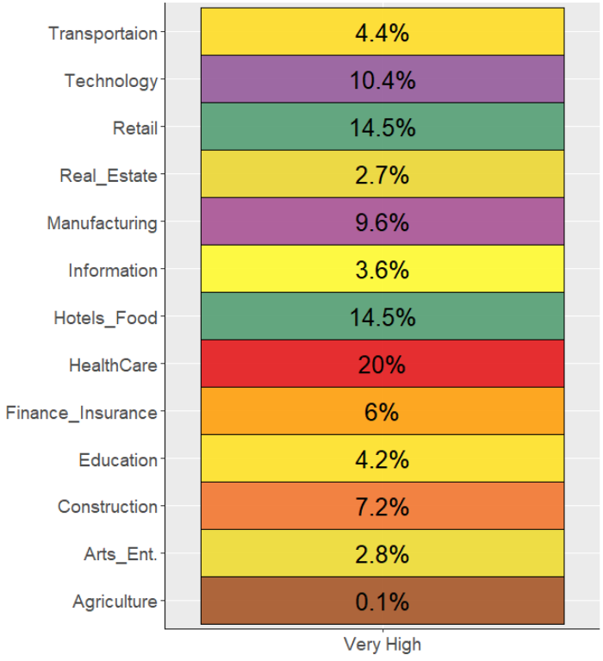
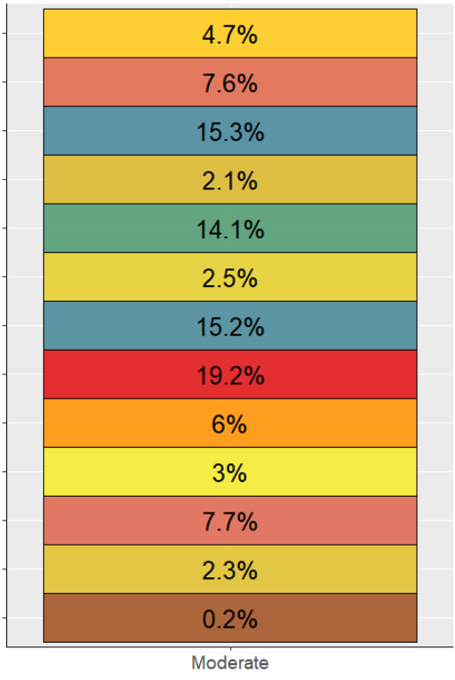
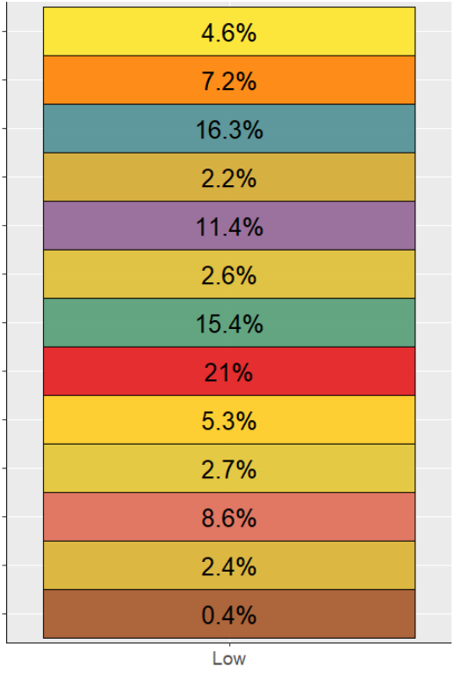

Demographic (Race)
SOCIAL
Job Distribution
★ | Transportation | -0.081
★ ★ | Technology | 0.501
★ | Retail | -0.317
★ | Manufacturing | -0.182
★ | Hotel & Food | -0.152
★ | Healthcare | 0.166
★ | Firm size 100-499 | 0.344
★ | Firm size 500+ | 0.313
Job Field show similar distribution in general regardless of COVID severity, rather essential/service job rates are a little higher in COVID low states.

Slide 19
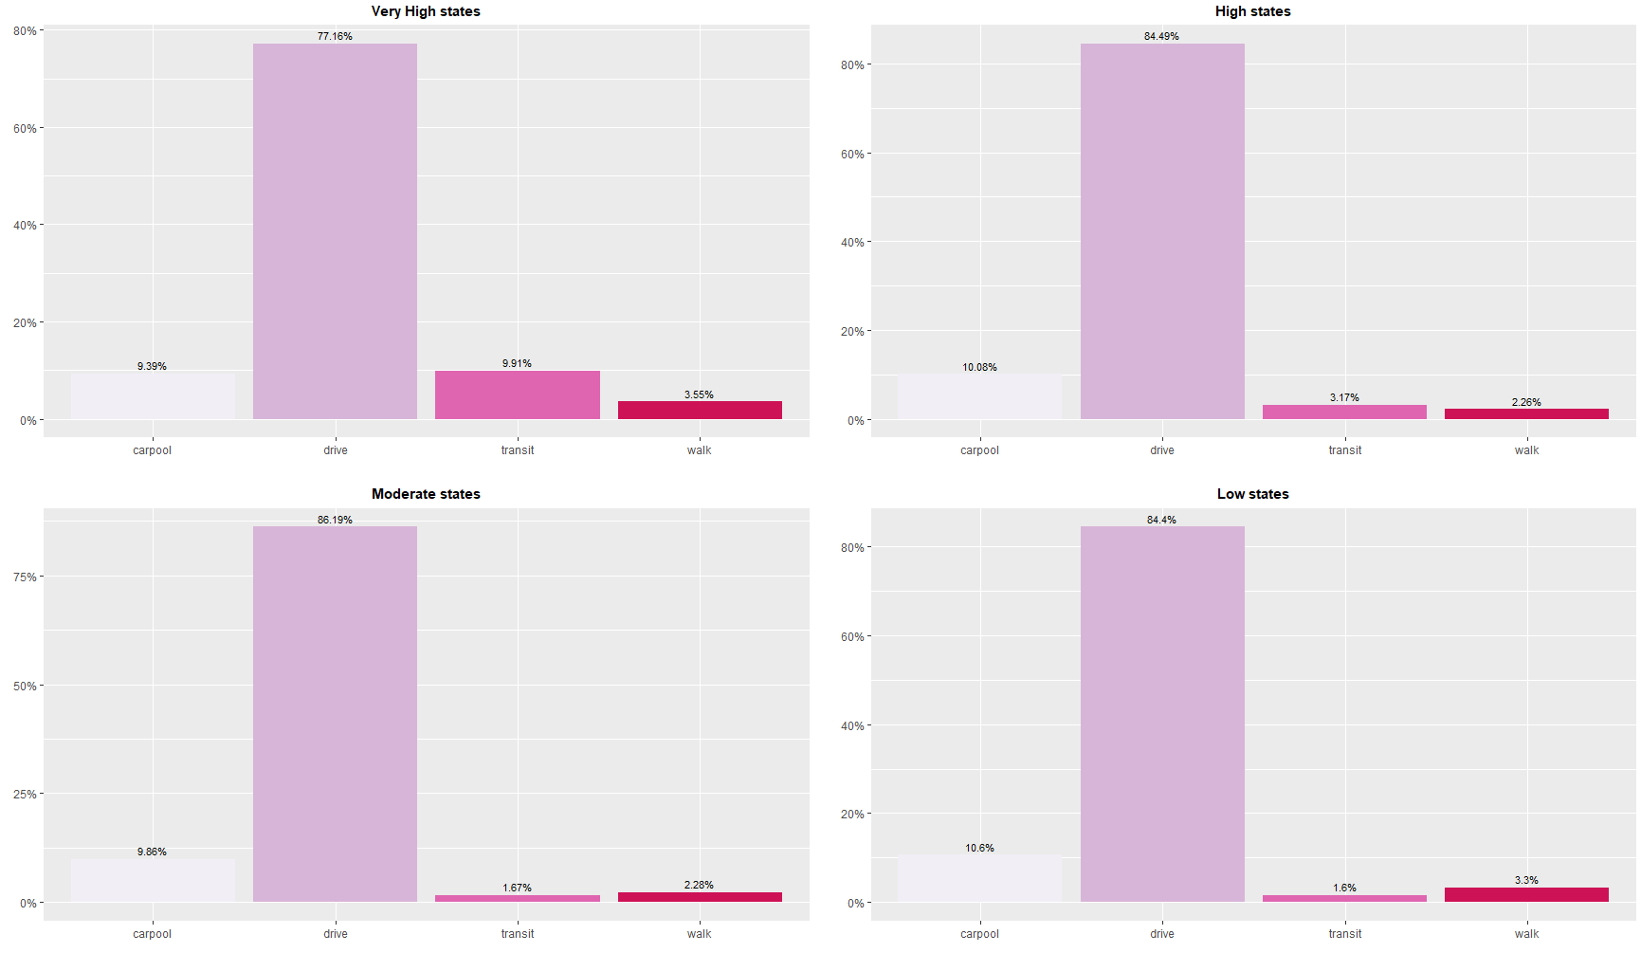
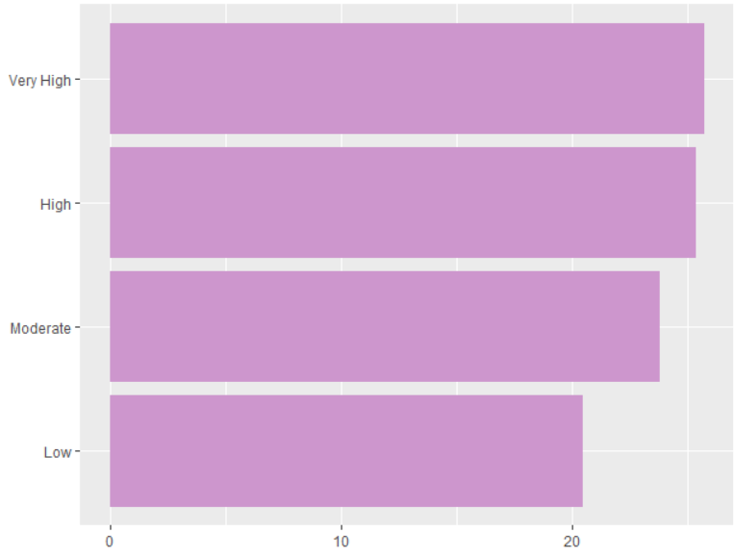
Demographic (Race)
SOCIAL
Commute Type
Commute Time
★ ★ ★ | Drive | -0.770
★★ | Carpool | -0.413
★ | Walk | 0.278
★ ★★ | Transit | 0.903
★ | Commute Time | 0.295
COVID high states show higher rate of transit and walk rate.
COVID high states have higher commute time.

Slide 20
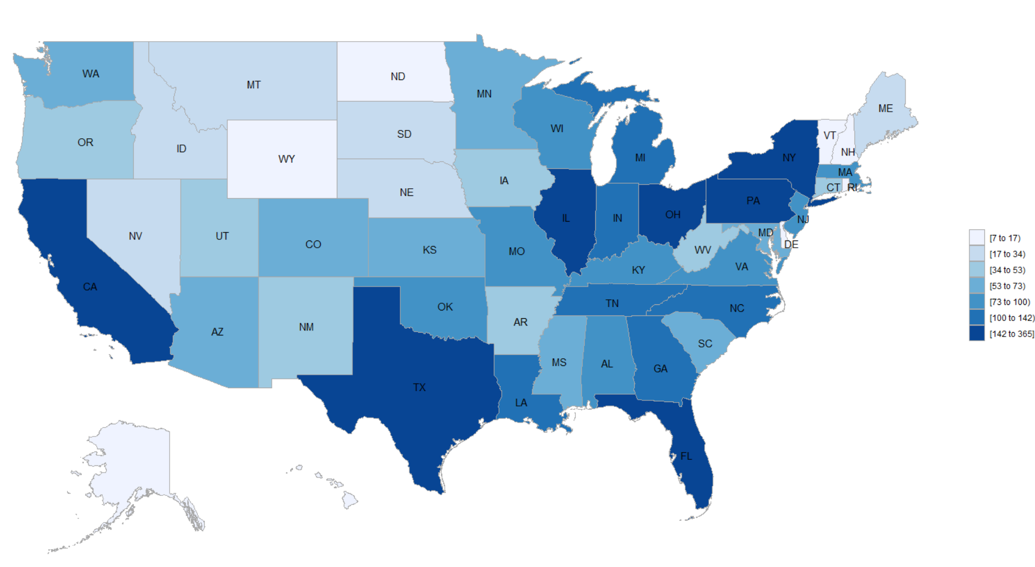
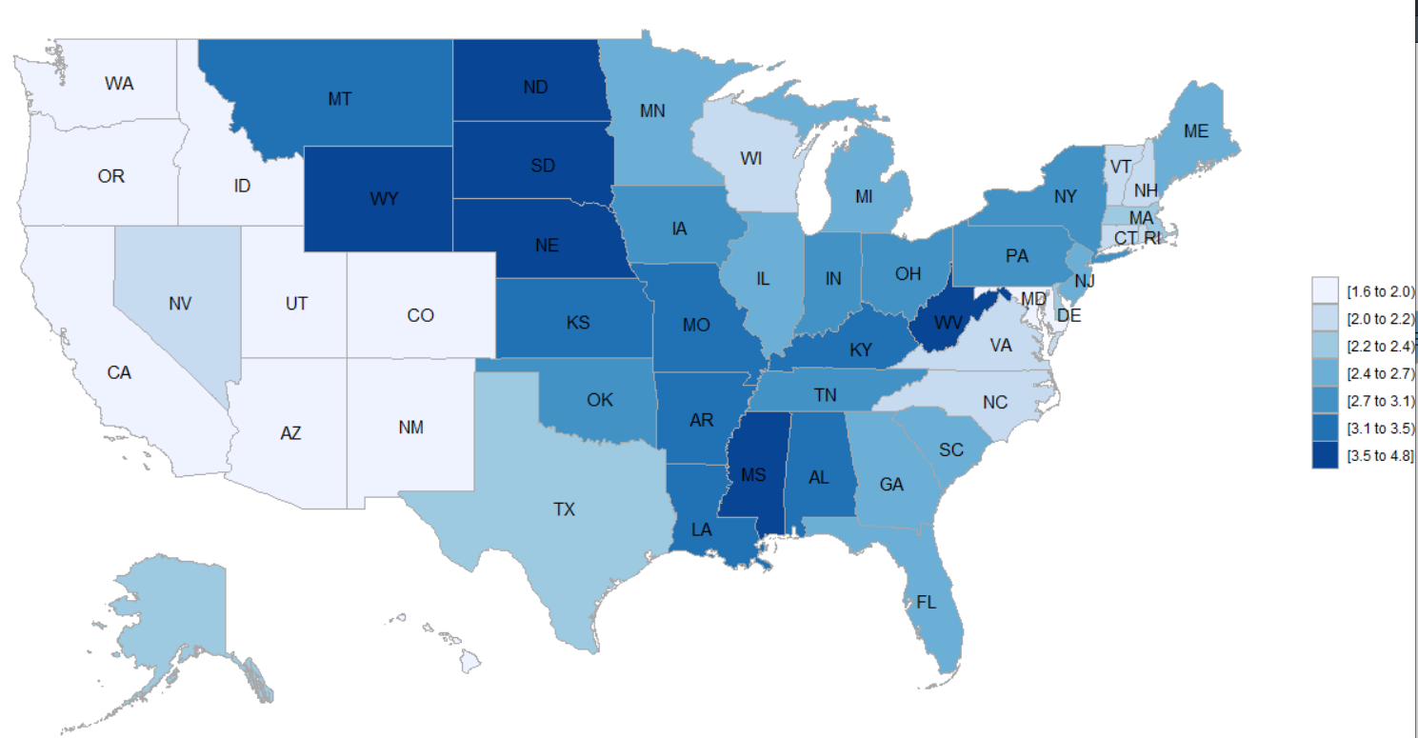
Demographic (Race)
HEALTHCARE
Hospital Numbers
Hospital beds per 1000
★ | Hospital Number | 0.388
★ | Hospital Bed Number per 1000 | -0.253
★ ★ | Patients Hospital Rating | -0.424
COVID high states have more hospital numbers considering their population.
But, the bed number per 1000 is lower, so does satisfaction and rating of hospital from the patients.

Slide 21
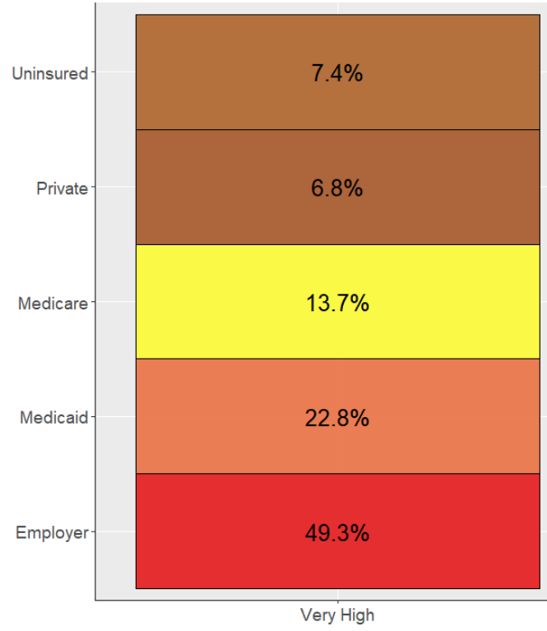
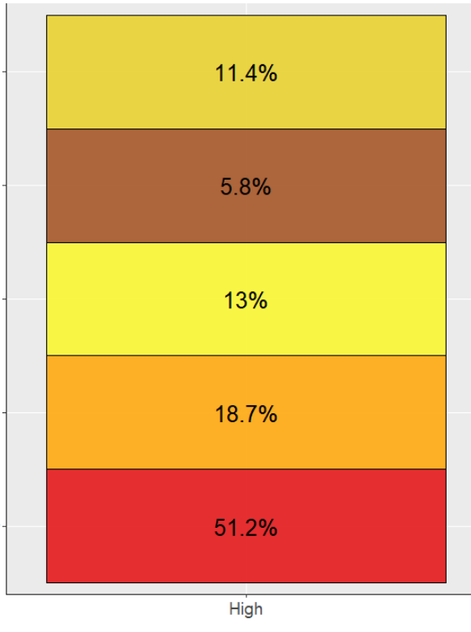
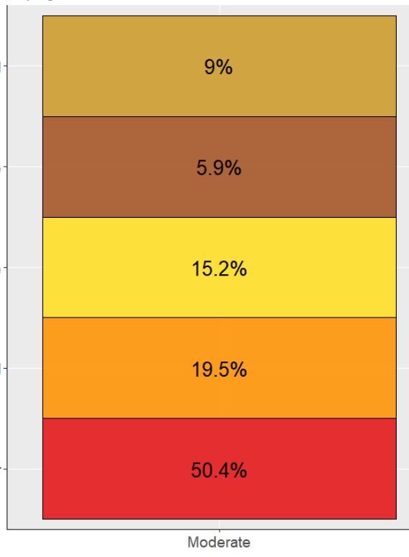
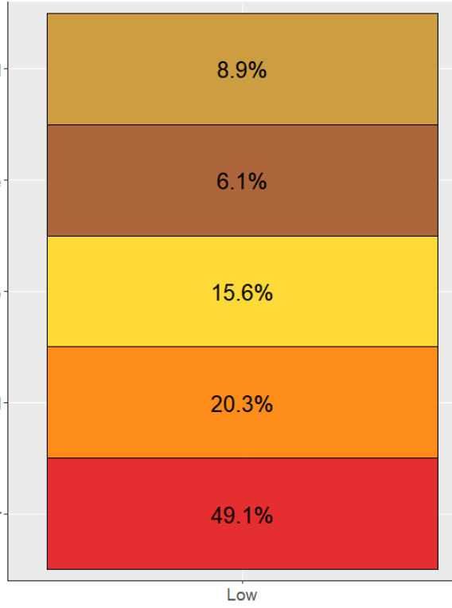
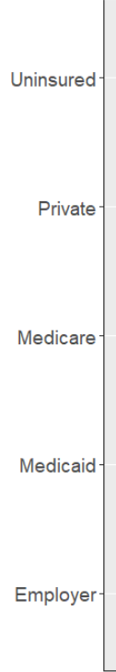
Demographic (Race)
HEALTHCARE
Insurance Type
★ | Employer | 0.016
★ | Private | -0.019
★ | Medicaid | 0.203
★ | Medicare | -0.261
★ | Uninsured | -0.174
The higher COVID case number, the higher uninsured rate, only except very high states group.
Very high group has highest Medicaid enrollment rate.

Slide 22
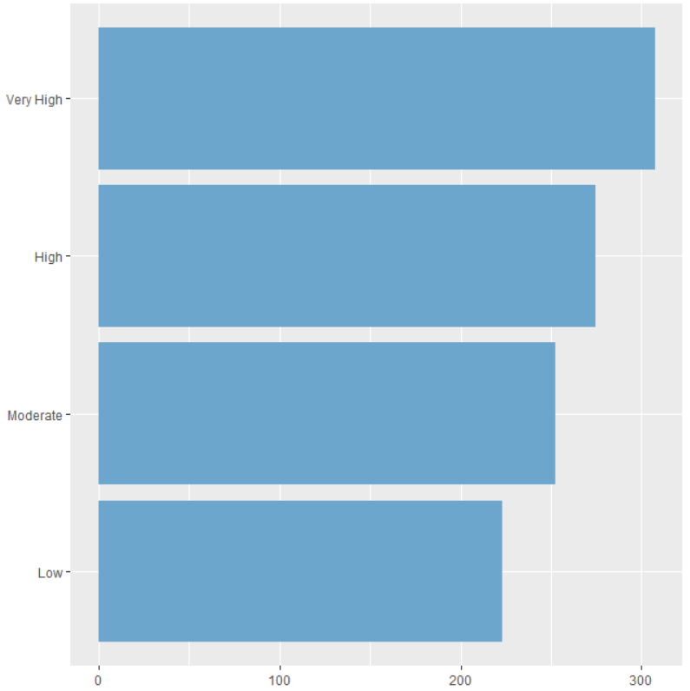
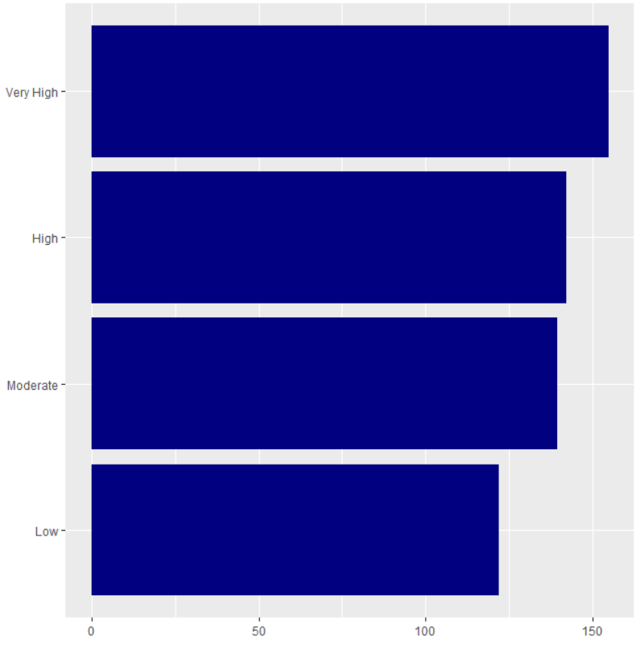
Demographic (Race)
HEALTHCARE
Avg. EM Waiting Min.
Rating
Avg. EM Spending Min.
★ ★ | Avg. Emergency Waiting Time | 0.443
★ | Avg. Emergency Spending Time | 0.363
★ | Patients Hospital Rating | -0.379
★ | Heart Attack Death Rate | -0.177
★ ★ | Heart Failure Death Rate | -0.418
★ | Pneumonia Death Rate | -0.222
★ | Pulmonic Death Rate | -0.273
8.91
9.02
9.05
9.07
COVID high states have longer emergency waiting and spending time with lower patient hospital ratings.
COVID and existing other disease fatality rates don’t explain much for the relevance.
COVID Level | Heart Attack Death Rate | Heart Failure Death Rate | Pulmonic Death Rate | Pneumonia Death Rate
Low | 0.125 | 0.121 | 0.086 | 0.157
Moderate | 0.128 | 0.116 | 0.088 | 0.159
High | 0.128 | 0.112 | 0.087 | 0.157
Very High | 0.123 | 0.107 | 0.081 | 0.151

Slide 23

Predictive Analysis

Slide 24
Demographic (Race)
Regression
Demographic
Coefficients | Estimate Std | Std. Error | t value | Pr (>|t|) | Significance
(Intercept) | -2.229e+05 | 1.067e+05 | -2.089 | 0.0426 | *
Totla pop | 4.981e+04 | 4.479e+04 | 1.112 | 0.0117
White Per | 2.138e-03 | 8.331e-04 | 2.566 | 0.2722 | *
Density | 6.333e+01 | 6.903e+01 | 0.917 | 0.3640
Never Married | 5.534e+05 | 3.004e+05 | 1.842 | 0.0722 | .
Advanced Degree | 1.214e+05 | 2.832.608e+05 | 0.466 | 0.6438
Multiple R-squared: 0.3826, Adjusted R-squared: 0.3125
F-statistic: 5.454 on 5 and 44 DF, p-value: 0.0005454
Economic
Coefficients | Estimate Std | Std. Error | t value | Pr (>|t|) | Significance
(Intercept) | -2.668e+05 | 1.144e+05 | -2.332 | 0.02425 | *
Monthly Mortgage | 7.097e+05 | 3.507e+05 | 2.024 | 0.04897 | *
Income | 4.527e+00 | 1.480e+00 | 3.059 | 0.00373 | **
Poverty Rate | -5.989e-01 | 1.843e-01 | -3.250 | 0.00219 | **
Total Homless | 1.547e+00 | 2.926e-01 | 5.288 | 3.51e-06 | ***
Multiple R-squared: 0.5147, Adjusted R-squared: 0.4716
F-statistic: 11.93 on 4 and 45 DF, p-value: 1.083e-06

Slide 25
Demographic (Race)
Regression
Social
Coefficients | Estimate Std | Std. Error | t value | Pr (>|t|) | Significance
(Intercept) | -2.229e+05 | 1.067e+05 | 2.113 | 0.04103 | *
Drive Rate | 4.981e+04 | 4.479e+04 | 2.837 | 0.00718 | **
Transit Rate | 2.138e-03 | 8.331e-04 | 7.346 | 7.21e-09 | ***
Firm_500+ | 6.333e+01 | 6.903e+01 | -2.015 | 0.00841 | **
Manufacturing | 5.534e+05 | 3.004e+05 | -2.776 | 0.36027
Retail | 1.214e+05 | 2.832.608e+05 | -0.926 | 0.26057
Transportation | -3.293e-06 | 1.864e-06 | 1.142 | 0.12330
Hotel & Food | 2.977e-05 | 1.212e-04 | 1.575 | 0.71330
Health Care | -2.229e+05 | 1.067e+05 | -0.367 | 0.52433
Technology | 4.981e+04 | 4.479e+04 | -2.212 | 0.03288 | *
Multiple R-squared: 0.8955, Adjusted R-squared: 0.8687
F-statistic: 33.42 on 10 and 39 DF, p-value: 4.767e-16
Notes:
Difference is very big.

Slide 26
Demographic (Race)
Regression
HealthCare
Coefficients | Estimate Std | Std. Error | t value | Pr (>|t|) | Significance
(Intercept) | 7.367e+05 | 5.470e+05 | 1.347 | 0.1856
Avg.EM Spending time | 2.954e+02 | 3.828e+02 | 0.772 | 0.4449
Hospital Number | 2.090e+02 | 7.872e+01 | 2.655 | 0.0113 | *
Bed per 1000 | 1.630e+04 | 9.151e+03 | 1.781 | 0.0825 | .
Patient Rating | -1.147e+05 | 5.493e+04 | -2.087 | 0.0433 | *
HeartAttack death | -1.151e+06 | 1.205e+06 | -0.955 | 0.3452
Pneumonia death | -0.171e+08 | 1.315e+06 | -0.894 | 0.3712
Employer | 4.387e+05 | 2.095e+05 | 2.094 | 0.0426 | *
Private | 8.408e+05 | 5.333e+05 | 1.577 | 0.1228
Medicaid | 4.985e+05 | 2.205e+05 | 2.261 | 0.0293 | *
Medicare | -6.513e+04 | 3.395e+05 | -0.192 | 0.8488
Uninsured | -1.134e+06 | 2.205e+06 | -0.895 | 0.3152
Multiple R-squared: 0.4721, Adjusted R-squared: 0.3533
F-statistic: 3.974 on 9 and 40 DF, p-value: 0.001103

Slide 27
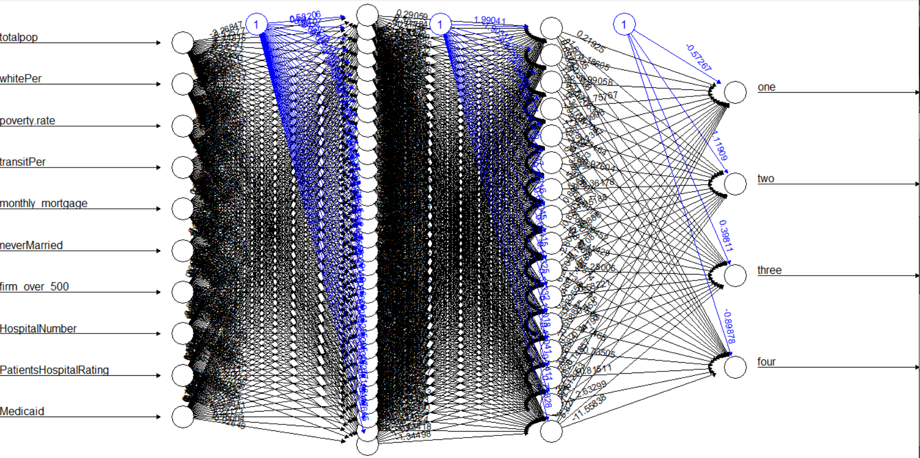
Demographic (Race)
Artificial Neural Network
Feature Selection
Input : 10 nodes → Hidden : 32*16 neurons → Output : 4 nodes
Total Pop+ White Per + Poverty + Transit + Monthly Mortgage + Never Married + Firm over 500 + Hospital num + Patient rating+ Medicaid
Accuracy
70%

Slide 28
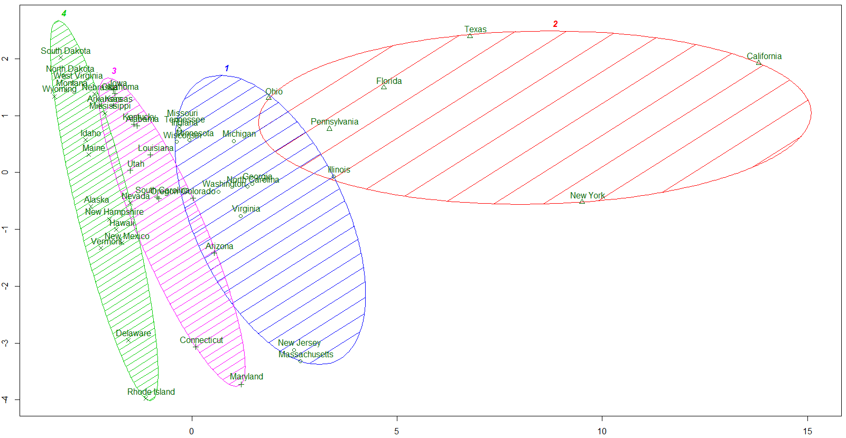
Demographic (Race)
K MEANS CLUSTERING
Accuracy
60%
COVID Cases | Cluster1 (High) | Cluster2 (Very High) | Cluster3 (Low) | Cluster4 (Moderate)
Mean | 24,346 (real : 18,782) | 70,180 (real : 81,329) | 2,861 (real : 1,677) | 10,357 (real : 5,839)
Sum | 292,152 | 491,262 | 57,218 | 113,930

Slide 29
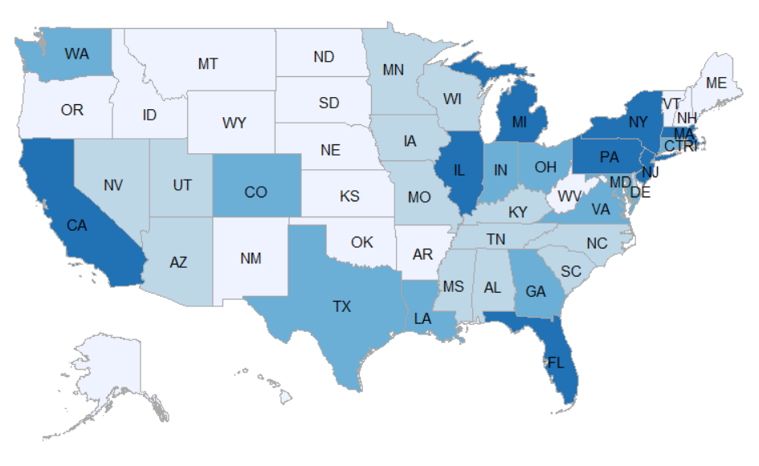
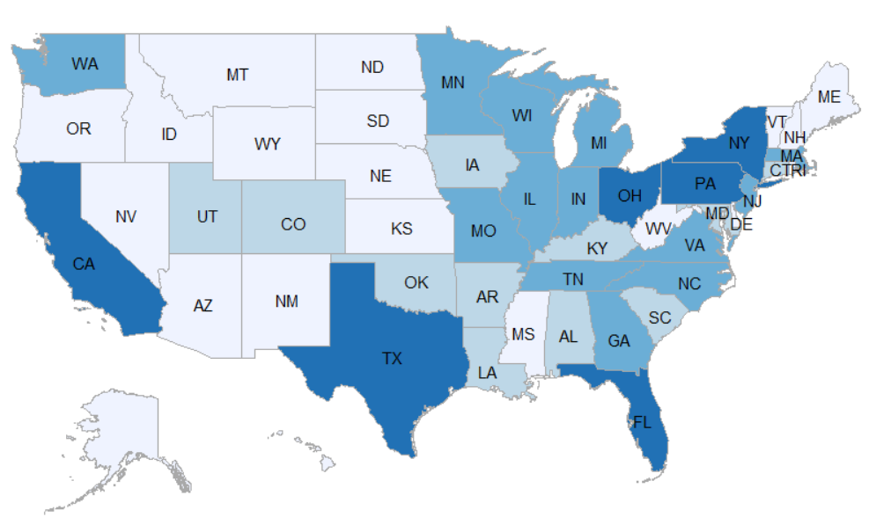
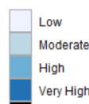
Demographic (Race)
K MEANS CLUSTERING
58%
VS
Grouping based on real cases
Clustering based on features
Low ( <3,500) // 17 states
Moderate ( <10,000) // 15 states
High ( <30,000) // 10 states
Very High (30,000 < ) // 8 states

Slide 30
Conclusion

Slide 31
Demographic
Density is the strongest factor in affecting COVID cases.
Higher COVID incidence is in regions having more Race diversity.
Economic
Higher COVID incidence is in regions having higher poverty and lower income.
Social
Higher COVID incidence is in regions having higher rate of essential job field.
HealthCare
Higher COVID incidence is in regions having higher fatality rate of other disease.

Slide 32





SOMEWHAT CONFUSED
+ Higher Income
+ Higher Education
+ More High-tech job
+ Lower Uninsured
+ Lower Disease fatality
- Higher Poverty
- More Homeless
- Higher Medicaid
- Longer Hospital time with
- Lower Patient Satisfaction
COVID
HIGH
States
N
O
T
J
UST
Diversity
Size
Personal attribute
Hospital Ability
B
U
T
Problem is
R
A
T
H
E
R
Polarization
Imbalance
Social Structure
Hospital Process
Detail Measures
Required
NOT from State perspective
BUT from County perspective
No More COVID AGAIN !!!

Slide 33


It’s DONE !!!

